Slide 1







JAVA OOP INOATIVE PROJECT
CAR RENTAL SYSTEM
BY - NISHITA MANHARSINH SOLANKI

Slide 2



ABOUT THE PROJECT
We have build a simple car rental system using oop concepts in java. It displays the the name , model, price per day of all the available car . And you can choose from the available car to rent.
When the car rental period is over you can return the car from the main menu itself.

Slide 3


OOP CONCEPTS USED
ENCAPSULATION
Definition: Encapsulation is the concept of bundling data (attributes) and methods (functions) that operate on the data into a single unit known as a class.
Purpose: It helps in hiding the internal details of an object and protecting its state. Access to the data is typically controlled through getter and setter methods.
2. INHERITANCE
Definition: Inheritance is a mechanism by which a new class can inherit properties and behaviors (fields and methods) from an existing class. The existing class is referred to as the base class or superclass, and the new class is the derived class or subclass.
Purpose: It promotes code reuse and establishes a relationship between classes, allowing the derived class to inherit and extend the functionality of the base class.

Slide 4

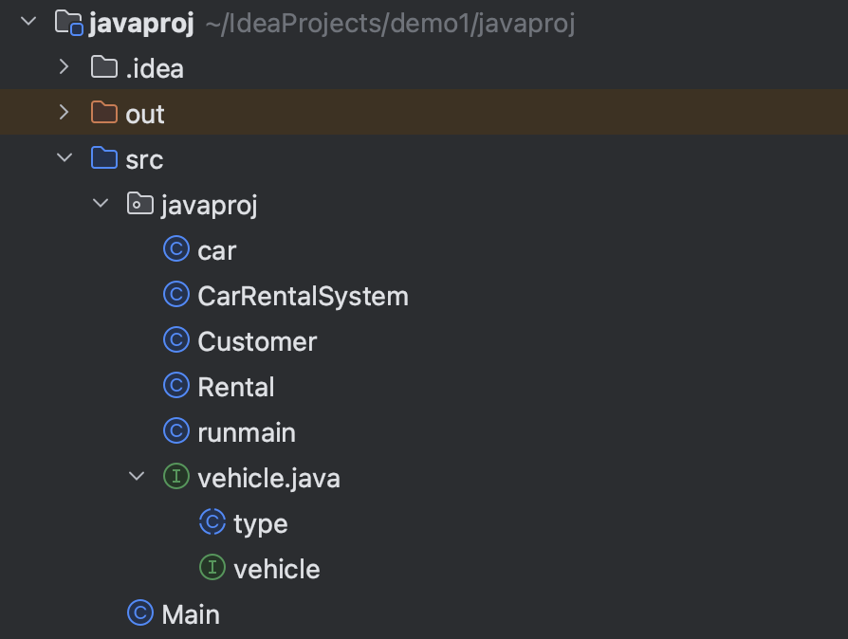

CODE WITH EXPLANATION
WE HAVE CREATED A PACKAGE “JAVAPROJ” WHICH INCLUDES ALL THE REQUIRED CLASSES, ABSTRACT , INTERFACE CLASSES.
PACKAGE “JAVAPROJ “ WITH ALL THE NECESSARY CLASSES
Packages in Java are a way to organize and structure code, manage naming conflicts, and control access to classes and members. They contribute to the modularization and maintainability of Java code.

Slide 5
vehicle.java class
package javaproj; //package
public interface vehicle {
public String getCarId() ;
public String getBrand() ;
public String getModel();
public double calculatePrice(int rentalDays) ;
public boolean isAvailable();
public void rent();
public void returnCar() ;
}
This is a inteface class where we have just declared the function body like it’s return type , function name. Body of the function will be definned in implemented class.

Slide 6
Abstract class - type.java
abstract class type{
public String carId;
public String brand;
public String model;
public double basePricePerDay;
public boolean isAvailable;
}
In this abstract class we have just declare the datatype it will be override in the car class and other classes.

Slide 7
car.java
package javaproj;
public class car extends type implements vehicle {
public car(String carId, String brand, String model, double basePricePerDay) {
this.carId = carId;
this.brand = brand;
this.model = model;
this.basePricePerDay = basePricePerDay;
this.isAvailable = true;
}
public String getCarId() {
return carId;
}
public String getBrand() {
return brand;
}

Slide 8
public String getModel() {
return model;
}
public double calculatePrice(int rentalDays) {
return basePricePerDay * rentalDays;
}
public boolean isAvailable() {
return isAvailable;
}
public void rent() {
isAvailable = false;
}
public void returnCar() {
isAvailable = true;
}
}
This is the car class which implements the vehicle interface class and extends the type abstract class

Slide 9
Customer.java
package javaproj;
class Customer {
public String customerId;
public String name;
public Customer(String customerId, String name) {
this.customerId = customerId;
this.name = name;
}
public String getCustomerId() {
return customerId;
}
public String getName() {
return name;
}
}
This is the customer class which stores the info about customer like customer id and name.

Slide 10
Rental.java class
package javaproj;
class Rental {
public car car;
public Customer customer;
public int days;
public Rental(car car, Customer customer, int days) {
this.car = car;
this.customer = customer;
this.days = days;
}
public car getCar() {
return car;
}
public Customer getCustomer() {
return customer;
}
public int getDays() {
return days;
}
}
This rental car contains car of car dataype , customer of customer datatype and int days which stores the info about which customer has taken which car for rent and for how many days.

Slide 11
Car Rental System class
package javaproj;
import java.util.ArrayList;
import java.util.List;
import java.util.Scanner;
class CarRentalSystem {
private List<car> cars;
private List<Customer> customers;
private List<Rental> rentals;
public CarRentalSystem() {
cars = new ArrayList<>();
customers = new ArrayList<>();
rentals = new ArrayList<>();
}
public void addCar(car car) {
cars.add(car);
}
public void addCustomer(Customer customer) {
customers.add(customer);
}
public void rentCar(car car, Customer customer, int days) {
if (car.isAvailable()) {
car.rent();
rentals.add(new Rental(car, customer, days));
} else {
System.out.println("Car is not available for rent.");
}
}
public void returnCar(car car) {
car.returnCar();
Rental rentalToRemove = null;
for (Rental rental : rentals) {
if (rental.getCar() == car) {
rentalToRemove = rental;
break;
}
}
if (rentalToRemove != null) {
rentals.remove(rentalToRemove);
} else {
System.out.println("Car was not rented.");
}
}
public void menu() {
Scanner scanner = new Scanner(System.in);
while (true) {
System.out.println("===== Car Rental System =====");
System.out.println("1. Rent a Car");
System.out.println("2. Return a Car");
System.out.println("3. Exit");
System.out.print("Enter your choice: ");
int choice = scanner.nextInt();
scanner.nextLine(); // Consume newline

Slide 12
if (choice == 1) {
System.out.println("\n== Rent a Car ==\n");
System.out.print("Enter your name: ");
String customerName = scanner.nextLine();
System.out.println("\nAvailable Cars:");
for (car car : cars) {
if (car.isAvailable()) {
System.out.println(car.getCarId() + " - " + car.getBrand() + " " + car.getModel());
}
}
System.out.print("\nEnter the car ID you want to rent: ");
String carId = scanner.nextLine();
System.out.print("Enter the number of days for rental: ");
int rentalDays = scanner.nextInt();
scanner.nextLine(); // Consume newline
Customer newCustomer = new Customer("CUS" + (customers.size() + 1), customerName);
addCustomer(newCustomer);
car selectedCar = null;
for (car car : cars) {
if (car.getCarId().equals(carId) && car.isAvailable()) {
selectedCar = car;
break;
}
}
if (selectedCar != null) {
double totalPrice = selectedCar.calculatePrice(rentalDays);
System.out.println("\n== Rental Information ==\n");
System.out.println("Customer ID: " + newCustomer.getCustomerId());
System.out.println("Customer Name: " + newCustomer.getName());
System.out.println("Car: " + selectedCar.getBrand() + " " + selectedCar.getModel());
System.out.println("Rental Days: " + rentalDays);
System.out.printf("Total Price: Rs%.2f%n", totalPrice);
System.out.print("\nConfirm rental (Y/N): ");
String confirm = scanner.nextLine();
if (confirm.equalsIgnoreCase("Y")) {
rentCar(selectedCar, newCustomer, rentalDays);
System.out.println("\nCar rented successfully.");
} else {
System.out.println("\nRental canceled.");
}
} else {
System.out.println("\nInvalid car selection or car not available for rent.");
}
} else if (choice == 2) {
System.out.println("\n== Return a Car ==\n");
System.out.print("Enter the car ID you want to return: ");
String carId = scanner.nextLine();
car carToReturn = null;
for (car car : cars) {
if (car.getCarId().equals(carId) && !car.isAvailable()) {
carToReturn = car;
break;
}
}

Slide 13
if (carToReturn != null) {
Customer customer = null;
for (Rental rental : rentals) {
if (rental.getCar() == carToReturn) {
customer = rental.getCustomer();
break;
}
}
if (customer != null) {
returnCar(carToReturn);
System.out.println("Car returned successfully by " + customer.getName());
} else {
System.out.println("Car was not rented or rental information is missing.");
}
} else {
System.out.println("Invalid car ID or car is not rented.");
}
} else if (choice == 3) {
break;
} else {
System.out.println("Invalid choice. Please enter a valid option.");
}
}
System.out.println("\nThank you for using the Car Rental System!");
}
}
This class creates arraylist of car, customer,rentals and add( ) function is used to add them in the arraylist.
And has main menu for car system which displays option to rent, return or exit from the car rental system.

Slide 14
runmain.java
package javaproj;
public class runmain{
public static void main(String[] args) {
CarRentalSystem rentalSystem = new CarRentalSystem();
car car1 = new car("C001", "Toyota", "Camry", 600.0);
car car2 = new car("C002", "Honda", "Accord", 750.0);
car car3 = new car("C003", "Mahindra", "Thar", 1100.0);
car car4 = new car("C004", "BMW", "BMW M3", 2100.0);
car car5 = new car("C005", "Ferrai", "Ferrari 812 Superfast", 3100.0);
rentalSystem.addCar(car1);
rentalSystem.addCar(car2);
rentalSystem.addCar(car3);
rentalSystem.addCar(car4);
rentalSystem.addCar(car5);
rentalSystem.menu();
}
}
This is the main class which adds all the cars and calls the rentalSystem main menu function to display the all the options.

Slide 15
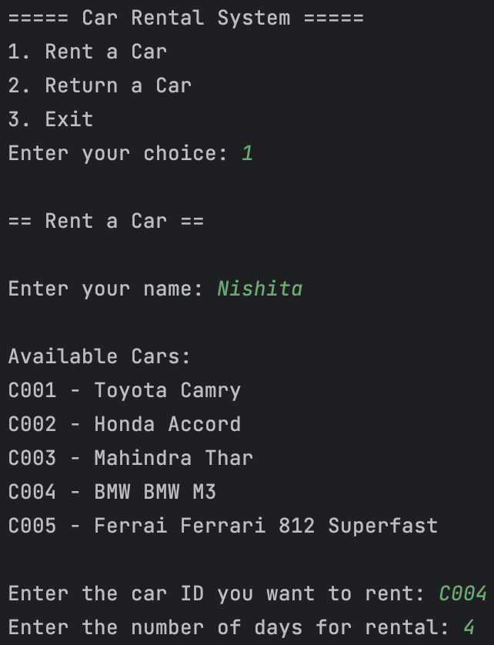
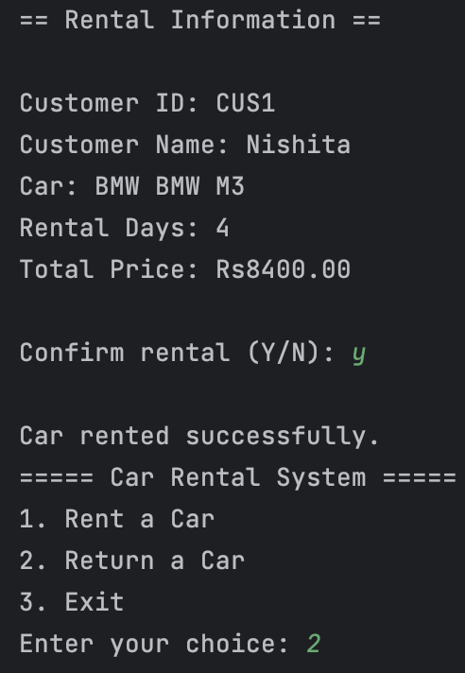
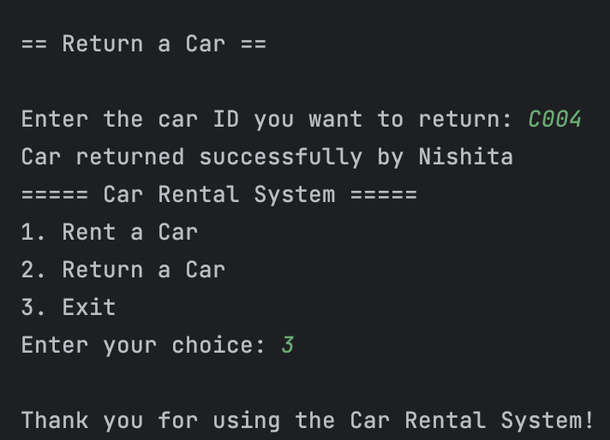
OUTPUT

Slide 16
Thank You!

